Slide 2
ALA WASHINGTON OFFICE
. . . THE VOICE OF LIBRARIES IN WASHINGTON FOR OVER 70 YEARS

Slide 4
LOGIC . . .

Slide 5
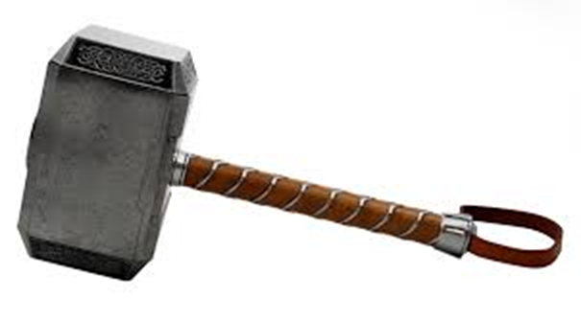
LOGIC . . .
. . . PERSUASION

Slide 6
LOGIC . . .
. . . PERSUASION
SPECIAL EQUIPMENT . . .

Slide 7
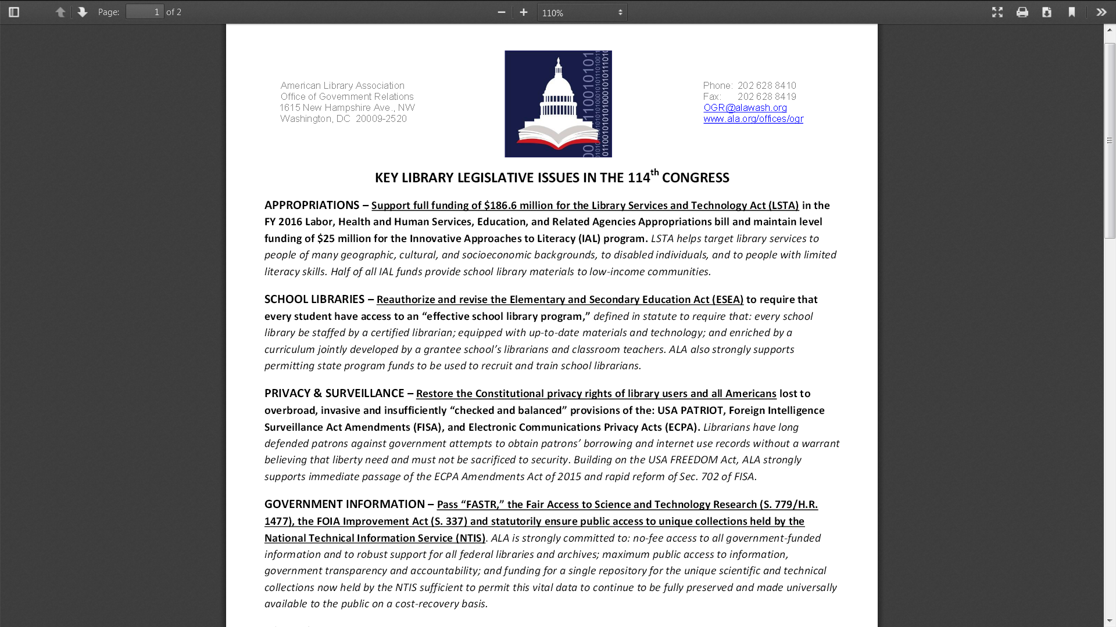

Slide 8
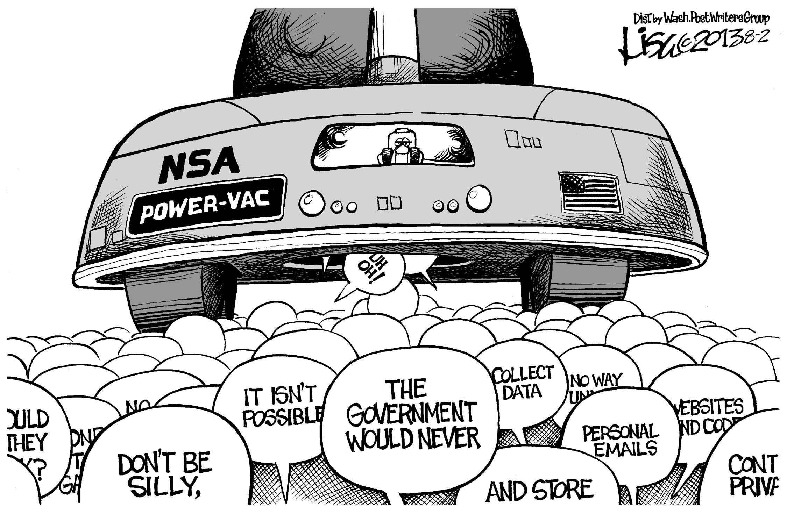
PRIVACY & SURVEILLANCE

Slide 9
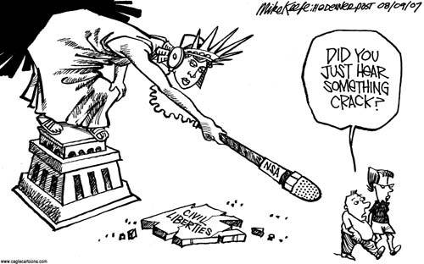

Slide 10
After being dogged by librarians and other protesters during a cross-country tour to boost support for the Patriot Act, Mr. Ashcroft last month accused librarians of being "duped" by liberals, and for two days running accused them of "hysteria."
Wall Street Journal
October 28, 2003

Slide 11
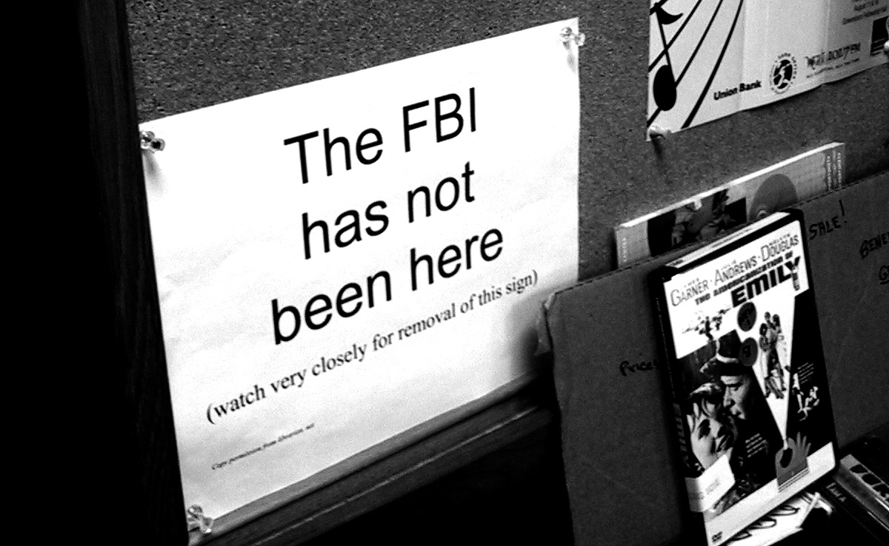

Slide 13
ECPA overhaul way “Oprah”-due
September 15, 2015

Slide 14
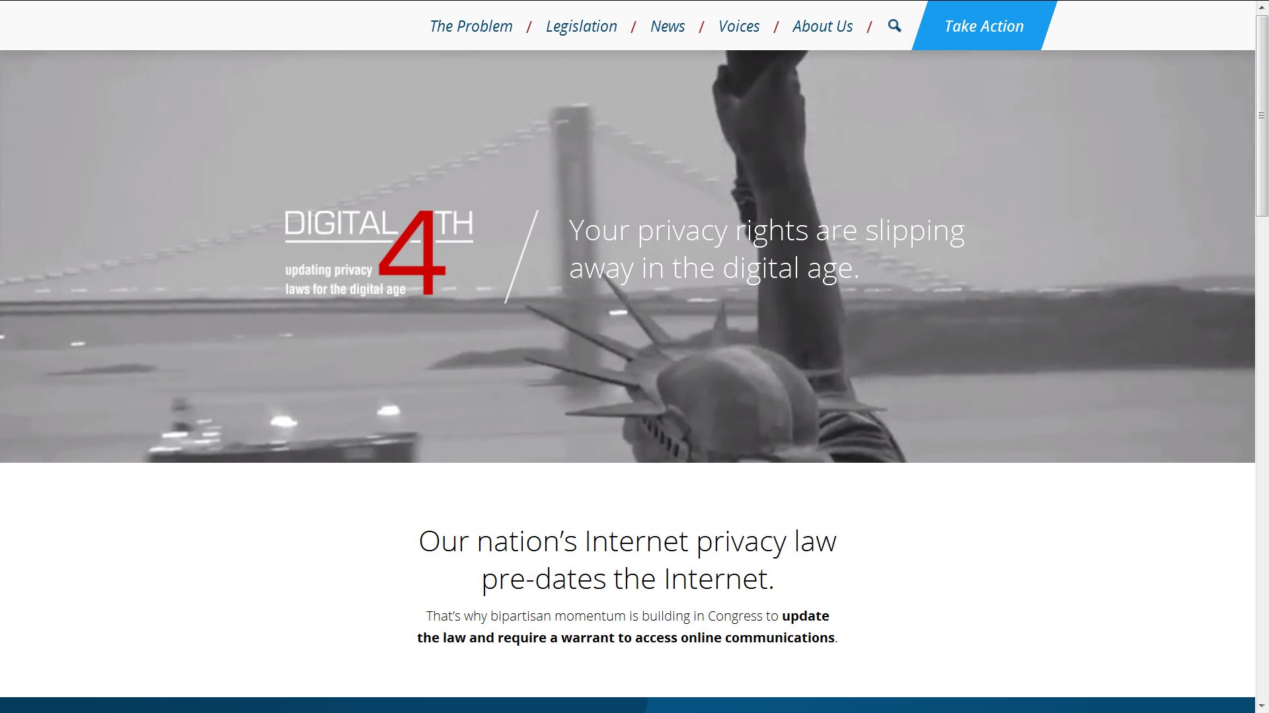

Slide 16
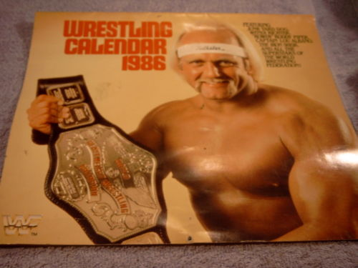

Slide 17
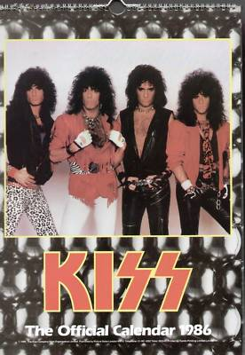

Slide 19
So, how long ago was 1986 ? ! ?

Slide 20
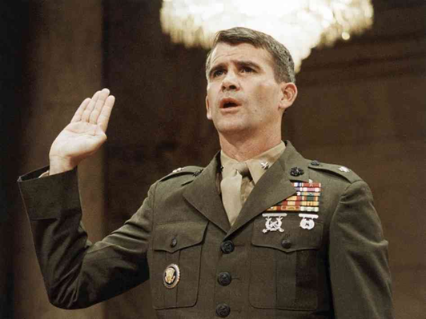
So, how long ago was 1986 ? ! ?

Slide 21
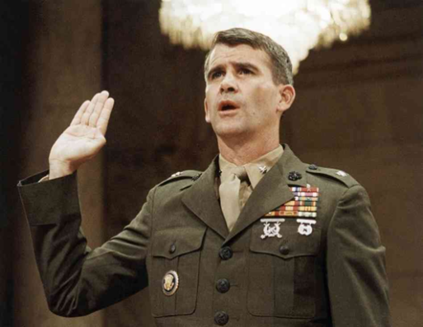
So, how long ago was 1986 ? ! ?

Slide 23
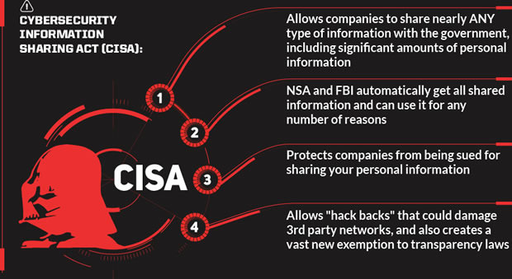

Slide 25
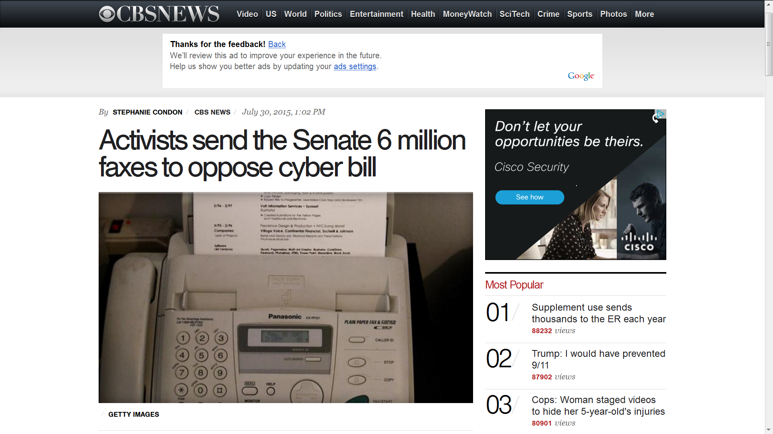

Slide 26
ALA president urges senators to join
Wyden, Paul and Sanders in opposing CISA
“When librarians oppose a bill with ‘information sharing’ in its name you can be sure that the bill is decidedly more than advertised. In fact, as Sens. Wyden, Paul and Sanders have courageously pointed out in opposition to it, the Cybersecurity Information Sharing Act would dramatically over-share the personal information of tens of millions of Americans who depend upon library computer networks, and could function, as a practical matter, as a new warrantless surveillance tool. ALA calls on all Senators to stand with Mr. Wyden, Mr. Paul and Mr. Sanders in keeping this privacy-hostile bill from the Senate floor until it is critically reformed.”
ALA President Sari Feldman
October 14, 2015

Slide 27
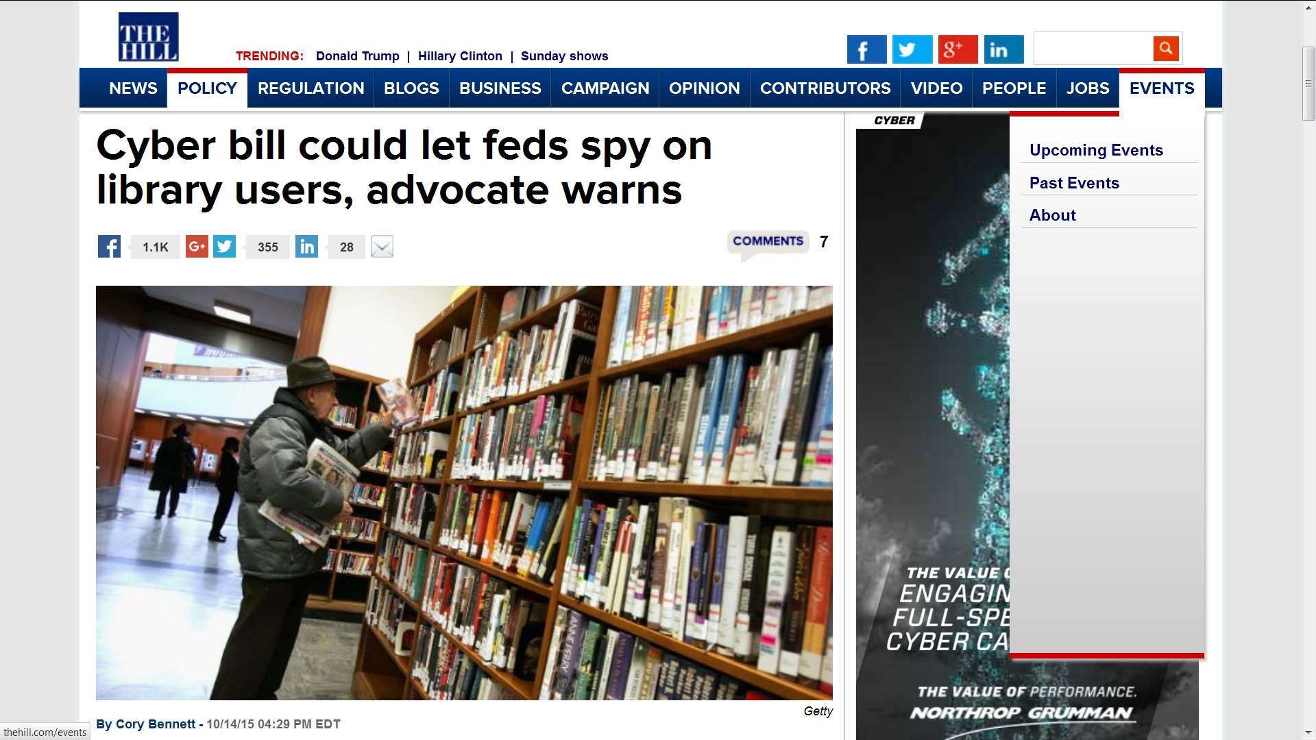

Slide 28
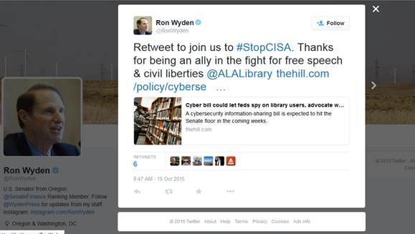

Slide 29
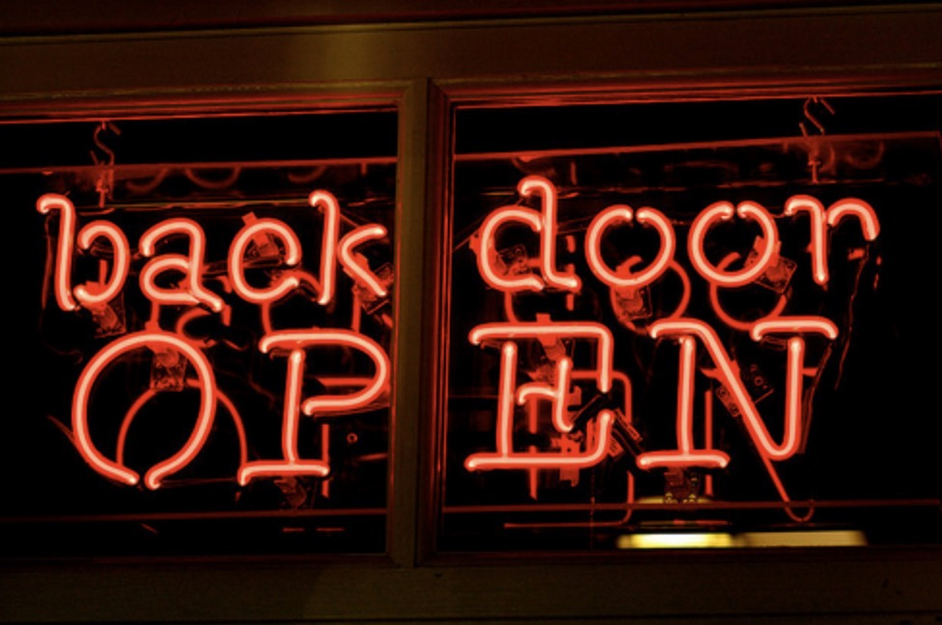

Slide 31
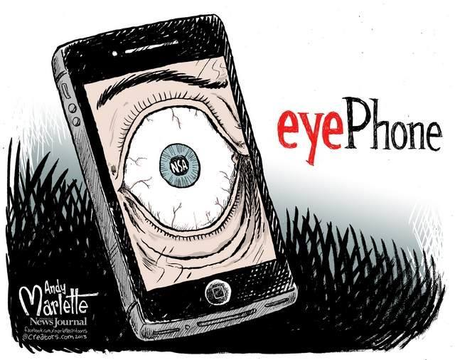

Slide 32
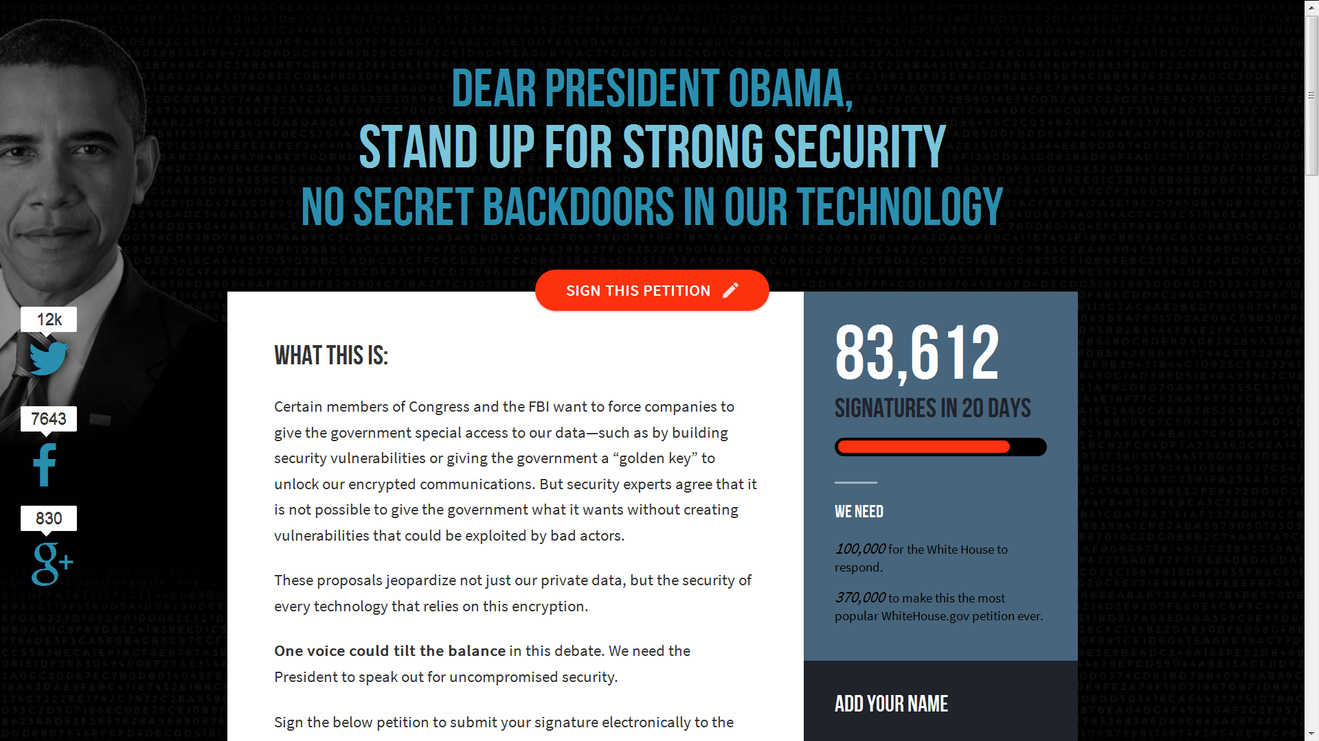
SAVECRYPTO.ORG

Slide 33
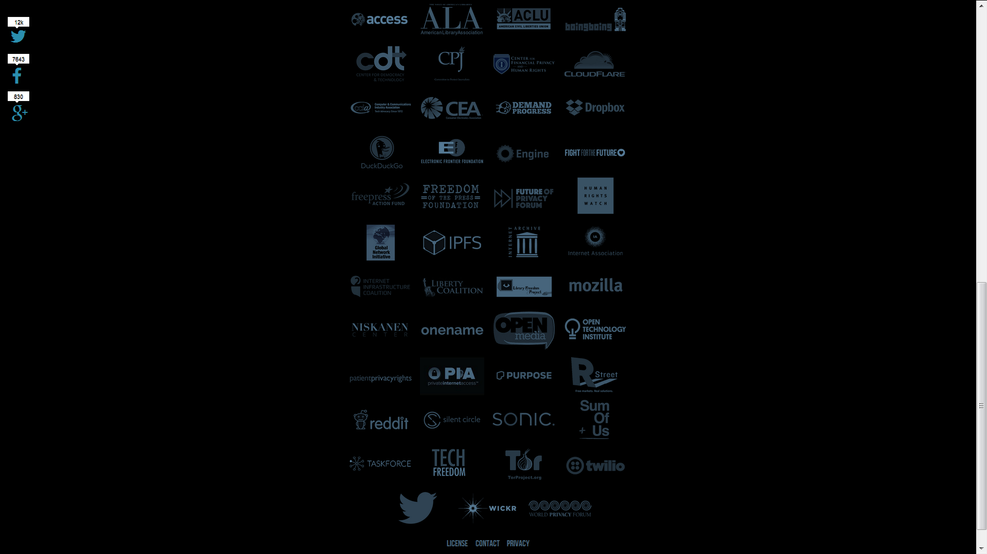

Slide 34
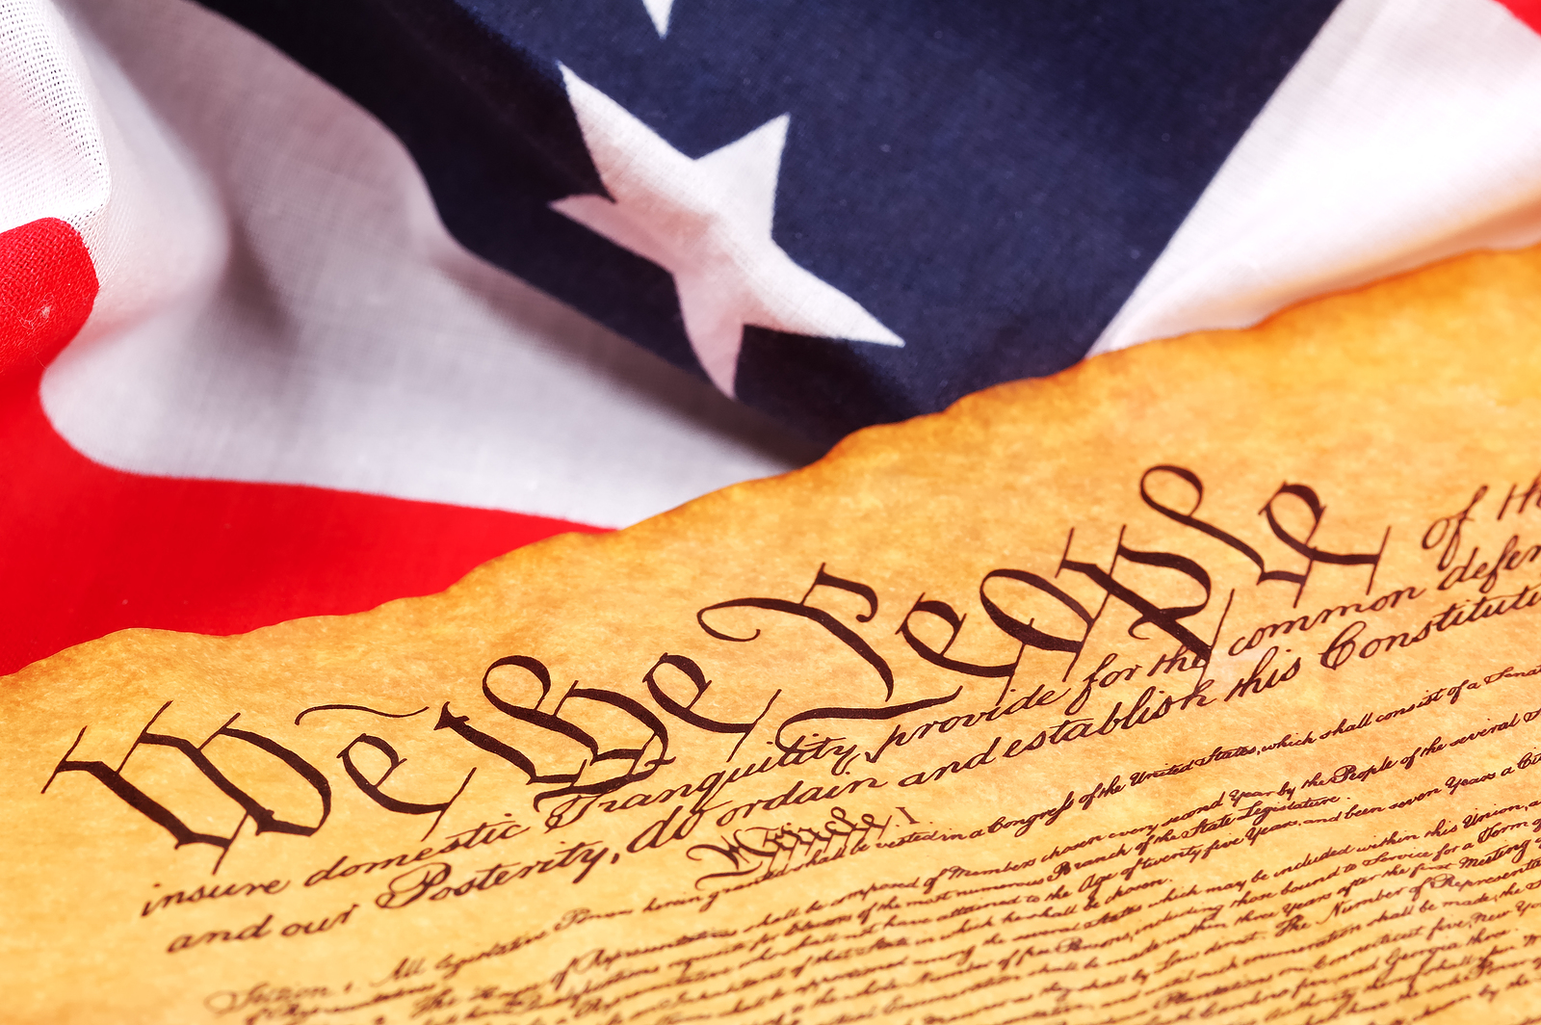

Slide 35
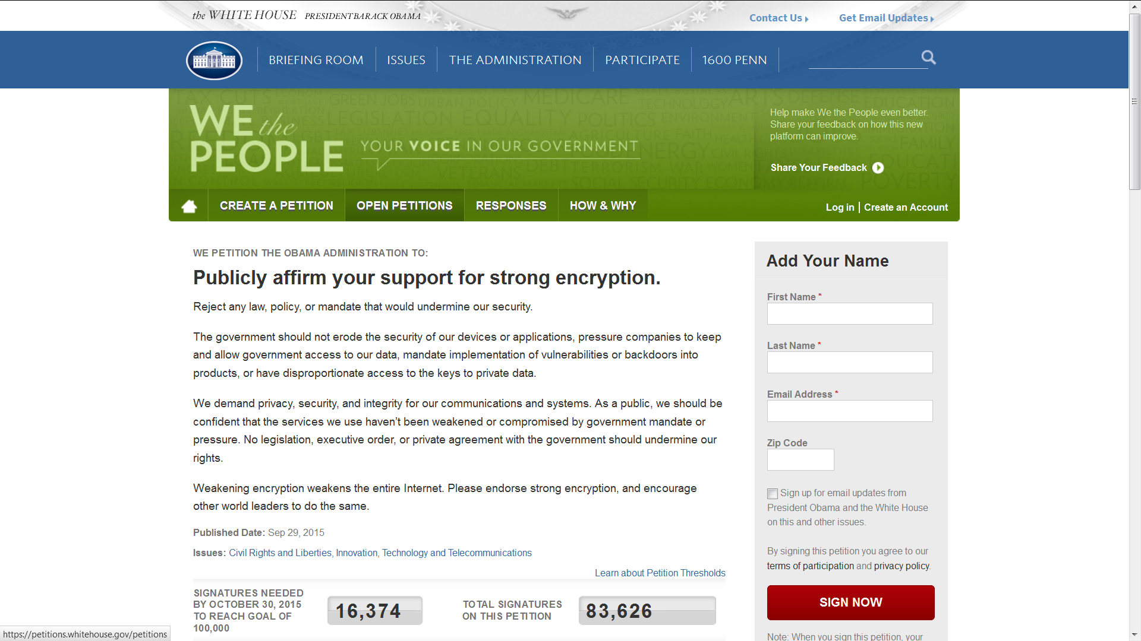

Slide 37
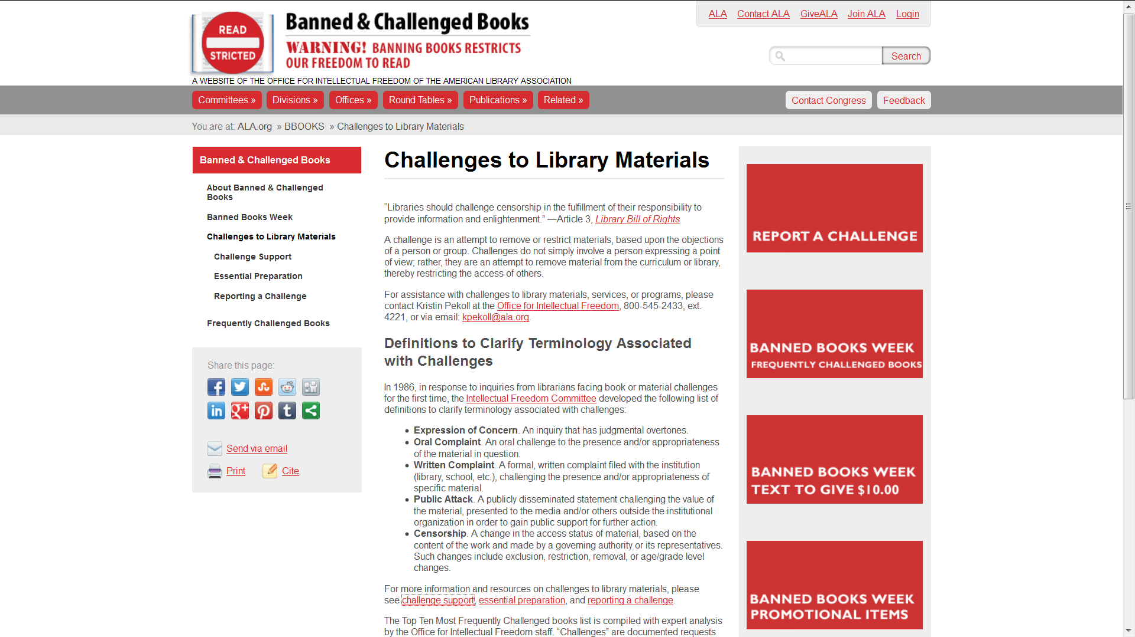

Slide 41
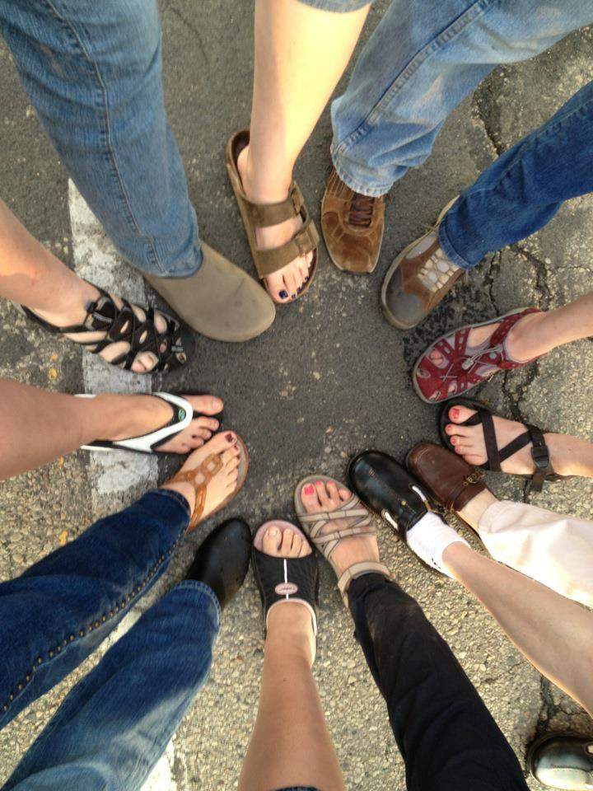

Slide 42
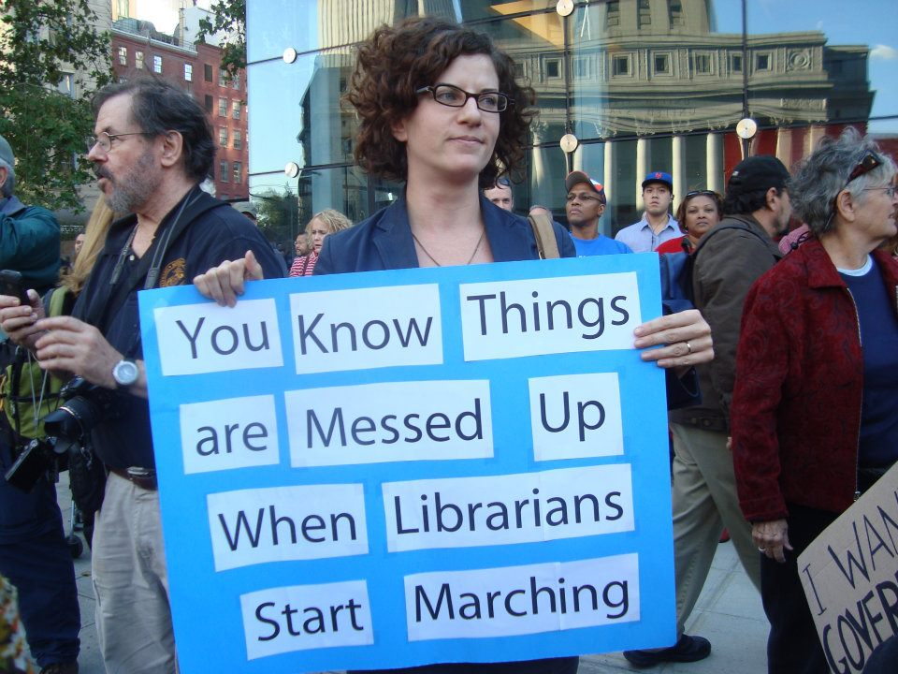

Slide 43
The Switch - Librarians won’t stay quiet
about government surveillance
By Andrea Peterson October 3, 2014

Slide 44
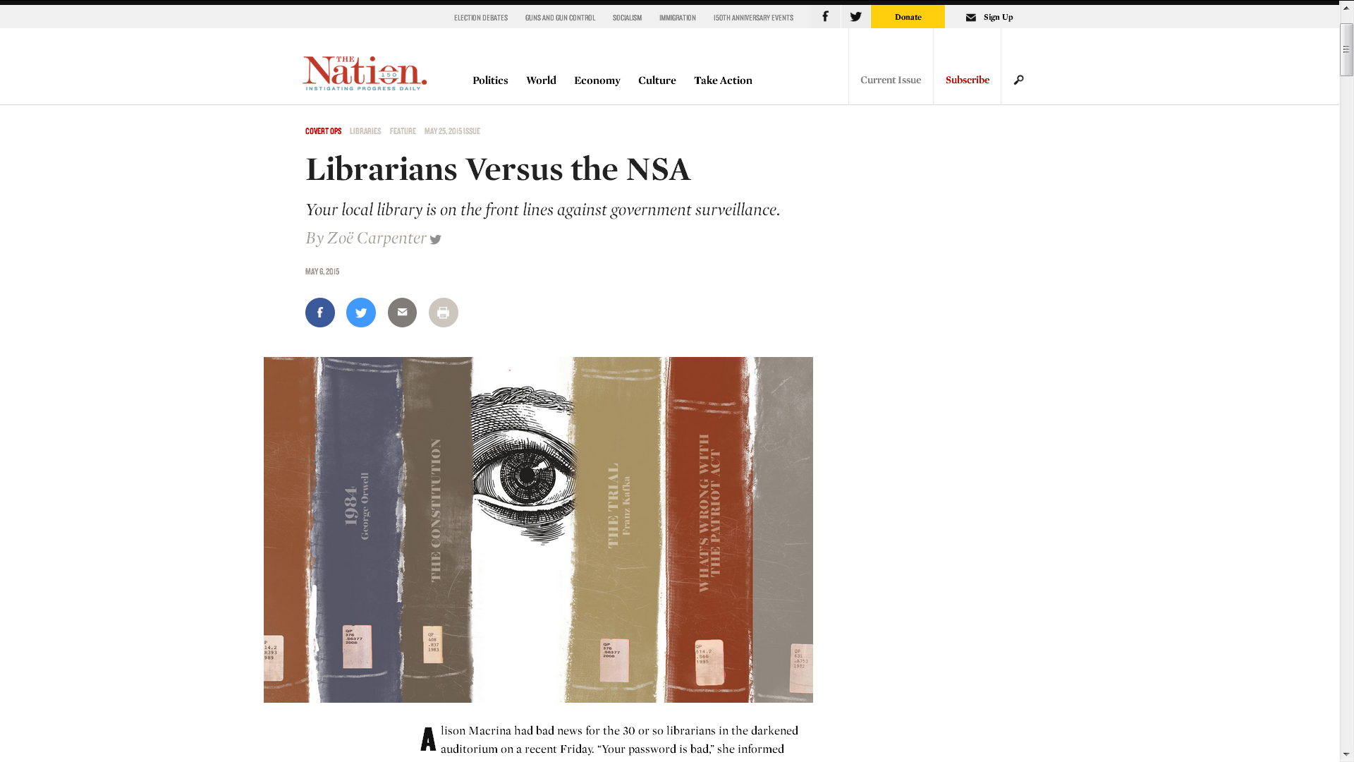
May 25, 2015

Slide 45
NATIONAL LIBRARY LEGISLATIVE DAY
CAPITOL HILL
WASHINGTON, DC
MAY 2 – 3, 2016

Slide 46
WWW.DISTRICTDISPATCH.ORG

Slide 47
WWW.ALA.ORG/ogr
800-941-8478

Slide 48
© 2015 NSA, All Data Retained

