Slide 1
The Future of Data Dissemination at the U.S. Census Bureau
Virginia Library Association
September 28, 2018
Rob Chestnut
Center for Enterprise Dissemination Services and Consumer Innovation (CEDSCI)
U.S. Census Bureau
Notes:
Good morning/afternoon and thank you for asking me to join you. My name is Rob Chestnut, and I am from the Center for Enterprise Dissemination Services and Consumer Innovation (CEDSCI). Notice the two important parts of CEDSCI - Enterprise Dissemination Services AND Consumer Innovation.
Today I’ll be talking about the future of data dissemination at the U.S. Census Bureau, and specifically how you can be involved and help us change the way we disseminate data.
This presentation will include a short history of data dissemination, a conceptual vision of where we’re headed and how we’re transforming the way customers access our data.
We will take a brief look at the dissemination platform that is under development and give you opportunity to provide feedback that we will use throughout to recreate the platform.
User feedback is an important part of the CEDSCI development process!

Slide 2
Census Bureau Mission and Vision
Mission: To serve as the nation’s leading provider of quality data about its people and economy.
Vision: To be the trusted source for timely and relevant statistical information, and the leader in data-driven innovation.
Notes:
First, let’s start with the Census Bureau’s mission and vision since it’s always good to come back to the mission and the vision.
The mission of our agency is to serve as the nations’ leading provider of quality data about its people and economy.
Our vision is to be the trusted source for timely and relevant statistical information, and the leader in data-driven innovation.
Naturally, data dissemination is built into the mission and vision of the Census Bureau (as being the provider and trusted source), and how we provide our data to you really matters to us.

Slide 3
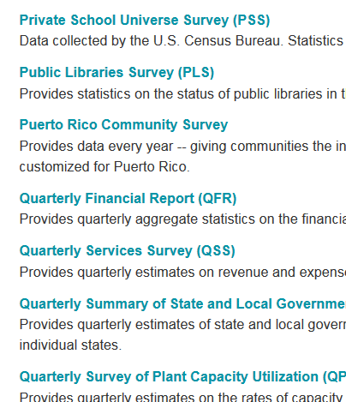
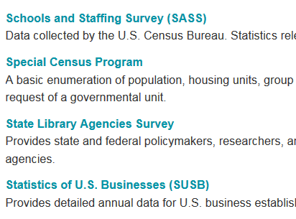
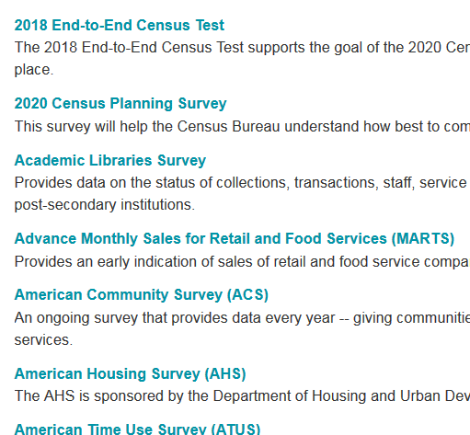
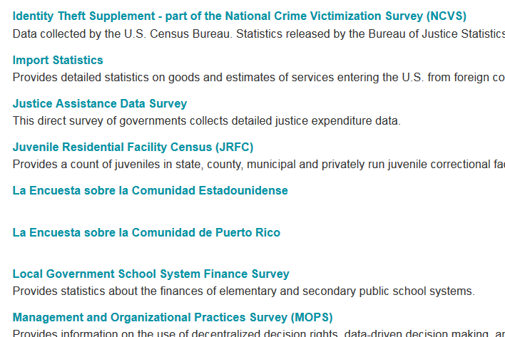
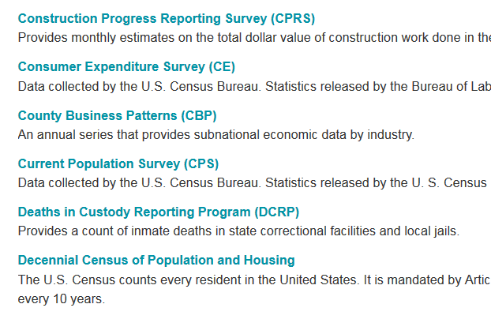
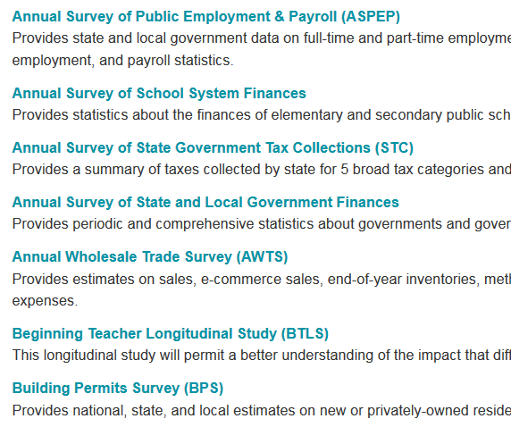
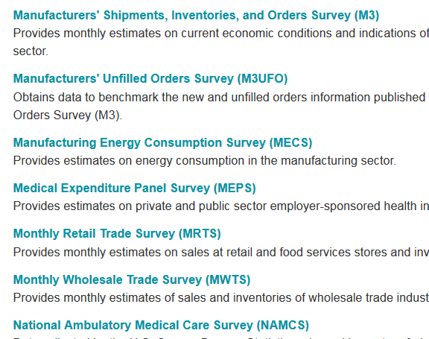
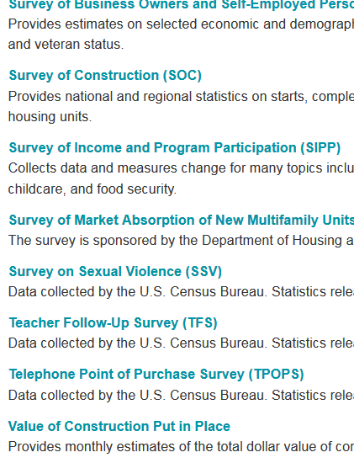
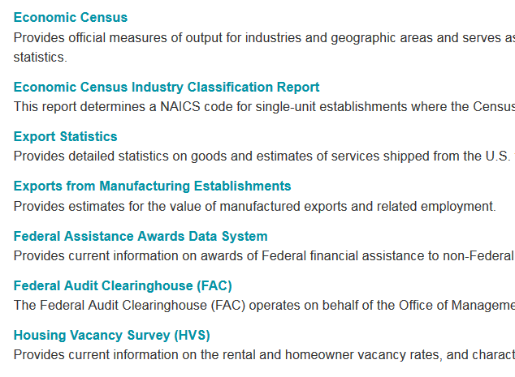
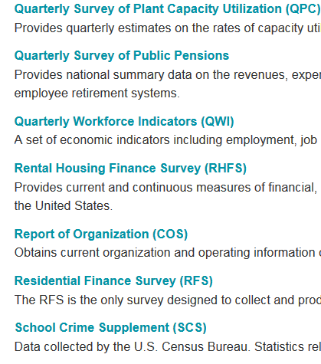
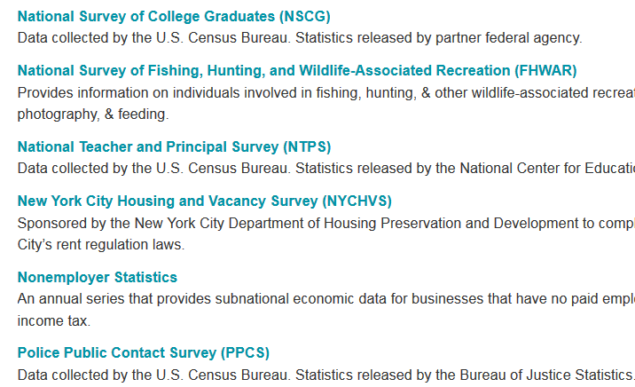
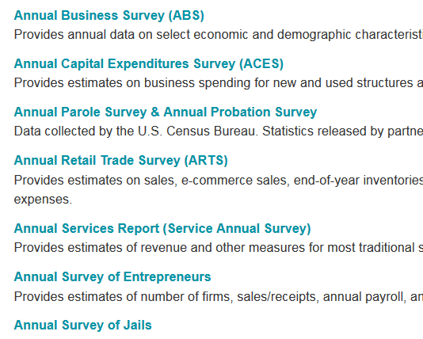
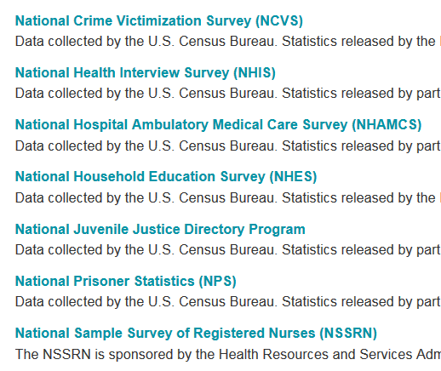
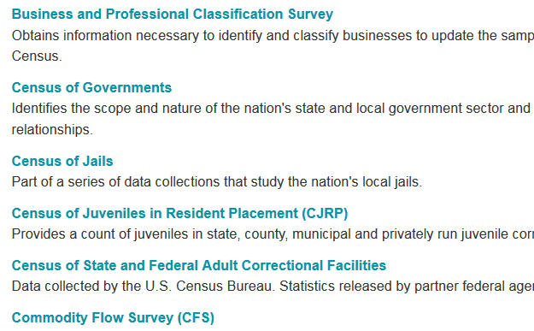
The Census Bureau has lots of data.
Notes:
So as you all know, we’ve got A LOT of data. You’re data users and know all that we have – estimates and census data (economic, 10 year population).
Just take a look at this list of data programs which include household and business surveys, estimates, and censuses.
We conduct more than one hundred surveys every year and from that alone we have a lot of data to process and even more that we could be sharing with the public.

Slide 4
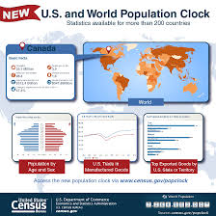
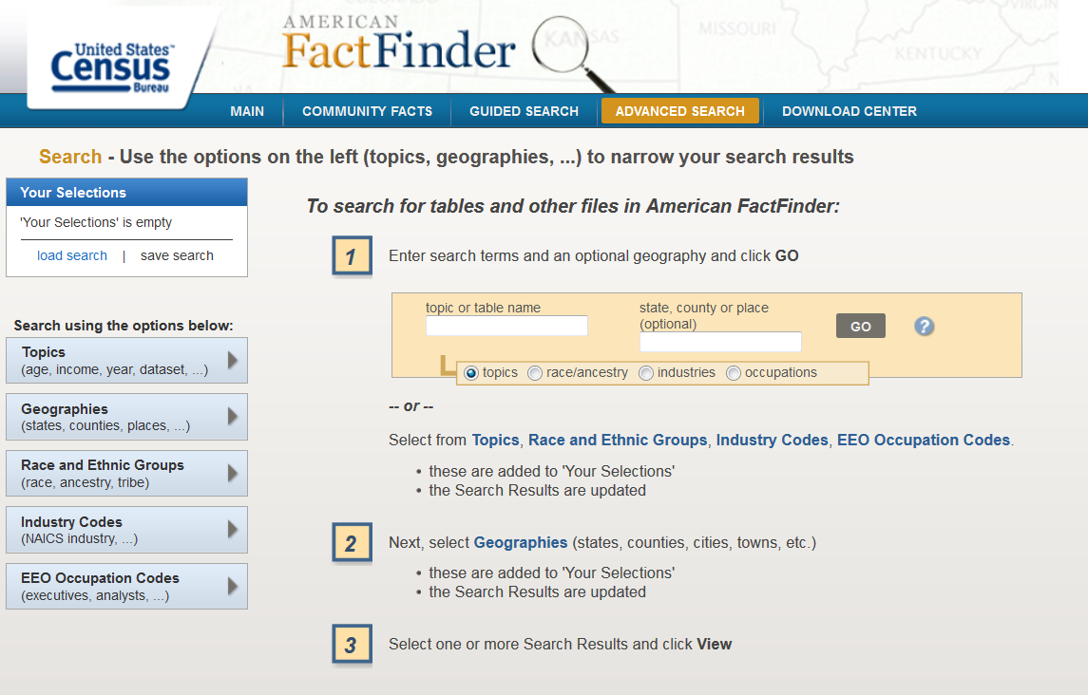
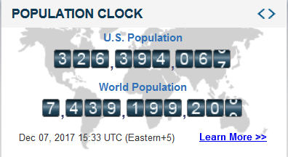
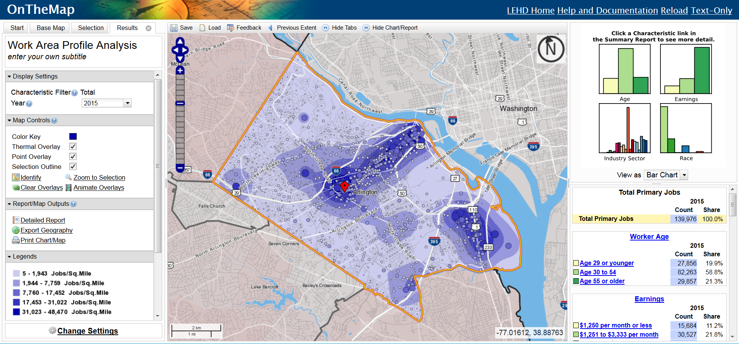
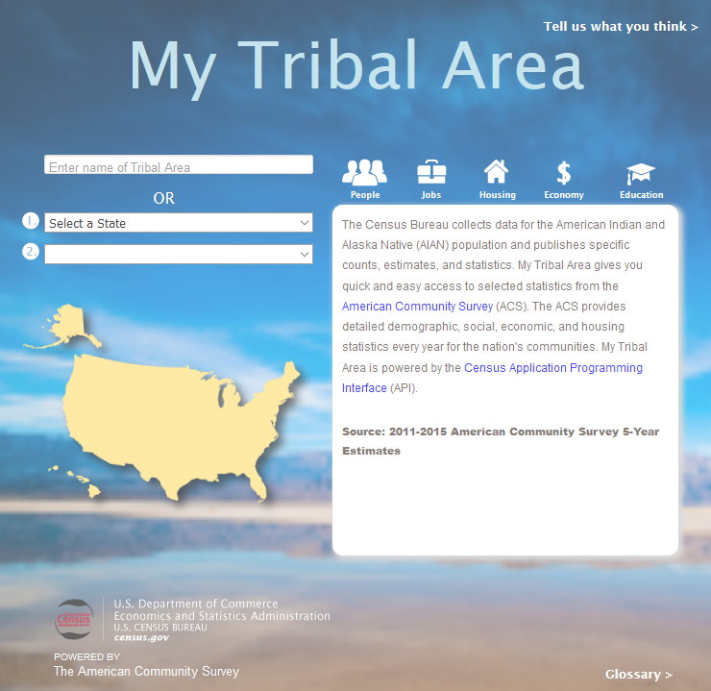
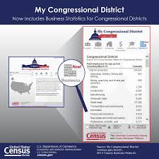
And, the Census Bureau has lots of tools for disseminating its data.
Notes:
And we’ve got lost of tools for accessing our data.
Some of these tools you know and love and use all the time. American Fact Finder, On the Map, The Pop Clock, My Congressional District. The list goes on and on.
As of last week, there were about 40 from which you could choose.

Slide 5
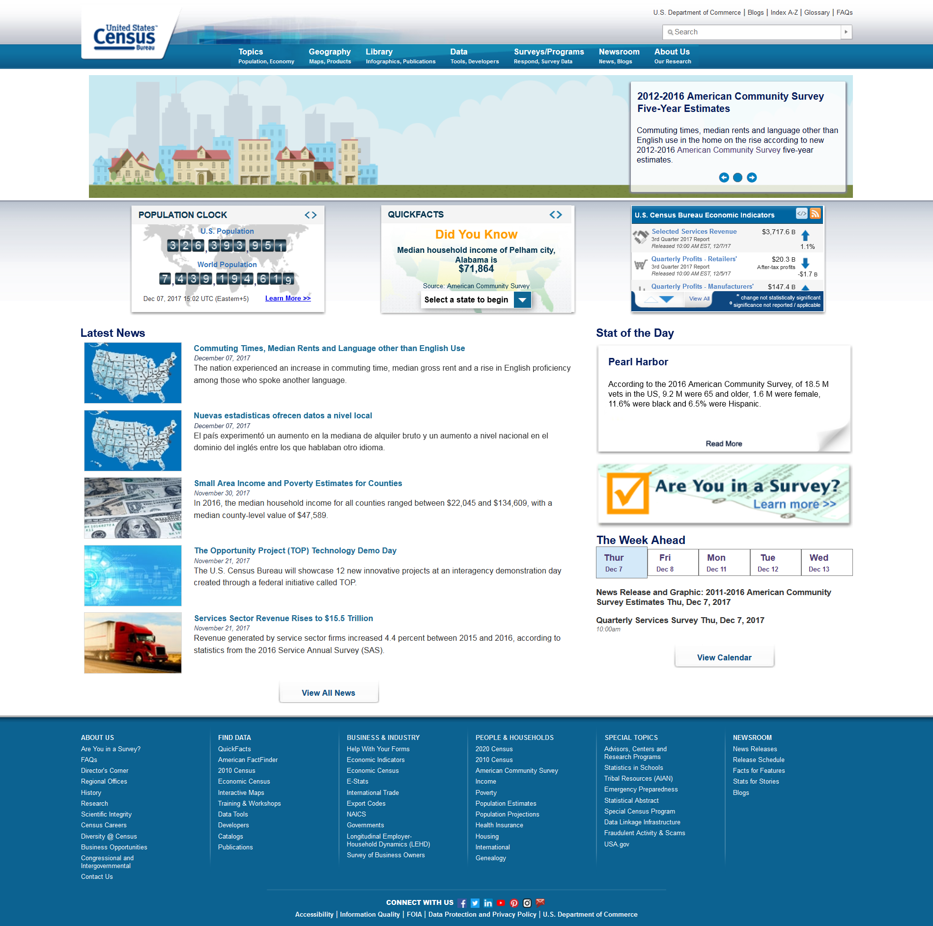
But, Census.gov overwhelms users.
Notes:
But, we’ve also got a problem. Because we’ve got so much great information, and so many tools, apps, visualizations, maps, videos, and…you get the point.
People sometimes find our website a little bit overwhelming, especially first time users who just want to get a quick population number or poverty stat.

Slide 6
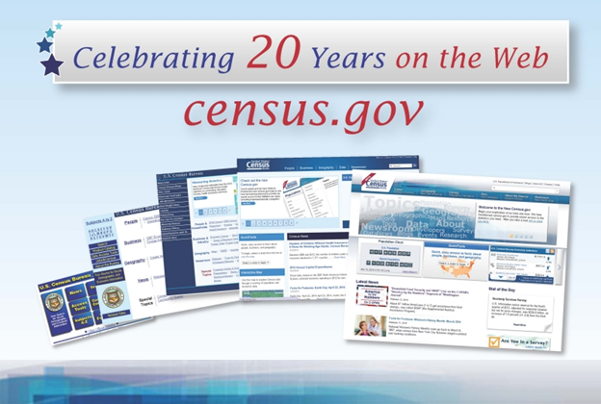
Census Bureau Online History
MABLE / Geo Correspondence Engine
CenStats
(USA Counties)
Quarterly Workforce Indicators &
On the Map
Census.gov
American
FactFinder
QuickFacts
WebMapper &
TIGERWeb
1994
1994
1994
1995
1996
1997
1999
1999
2000
2004
2006
2011
2012
2012
1990 Decennial Lookup
DataFerrett
(HTML)
DataFerrett
(Java)
SAIPE
Table Viewer
American FactFinder 2
PopClock
Open API
Notes:
So after 20 years of innovating online, and after developing hundreds of tools and apps, user feedback let us know we needed to change.
“Make it easier!” people said.
Simplify!
Give us a user-friendly way to access the data!
And, please don’t require us to know any of your jargon to find the data we’re looking for!

Slide 7
Solution: Enterprise Dissemination
Streamline user access to data
Maintain the best of our current tools
Reduce redundancies and operational costs
Provide greater access to Census Bureau API
Notes:
We heard the our data users and now we are addressing the needs of our customers through an enterprise dissemination frame work.
That means we’re looking at ways to streamline user’s access to data and improve their online experience.
We’re planning to maintain the best aspects and features or our current data tools.
But, we’re also reducing redundancies and operational costs by being more efficient and effect in the ways we disseminate data.
Though our enterprise dissemination environment, we’re also providing greater access to the Census Bureau API (and I’ll talk about that more in just a moment).

Slide 8
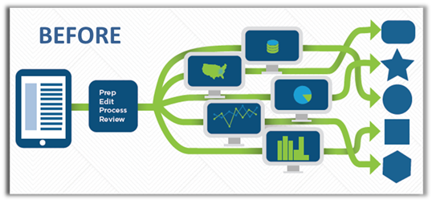
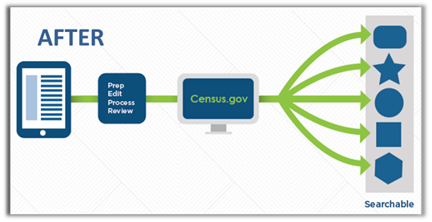
Moving from Before to After
Notes:
This gives a good picture of “before”
and what we want our “after” to be.
So, to move from our before pictures with dozens of data access points to our after environment, we’re working to create a Bureau-wide, enterprise dissemination platform.
A one-stop shop for accessing all our data, metadata, and content in one place.
And when we’re finished, you will get it all through a single, intuitive search on census.gov.

Slide 9
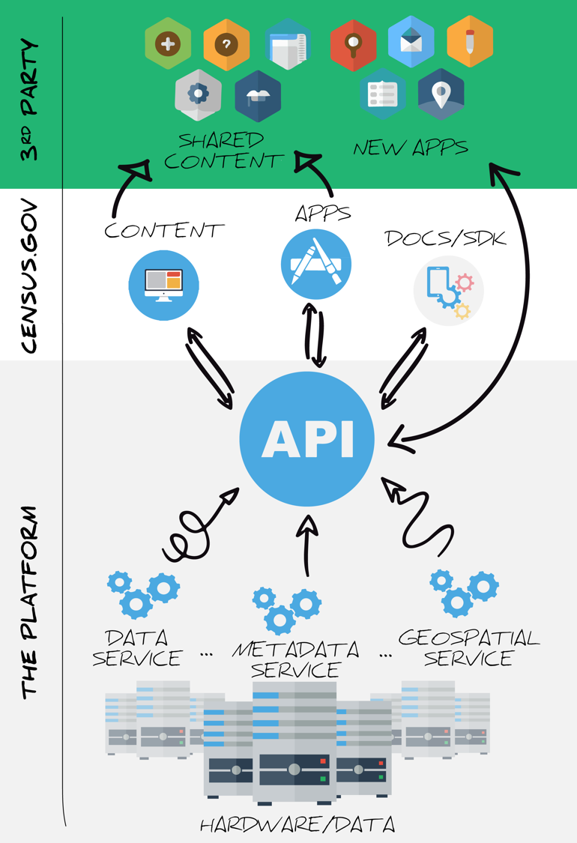
The New Dissemination Platform: How It All Works
Notes:
Let’s talk about that for a moment. The new data platform is built on the Census Bureau API or application programming interface.
The term may be unfamiliar, but it’s at the heart of what we’re doing and allows users greater flexibility in getting exactly the data they want without things they don’t need.
Essentially, as users search they will be making direct calls to our data, metadata, and geospatial services in a way that hasn’t previously been done at the Census Bureau.
So as we’re talking about the long-term nature of this project, you will certainly understand what an undertaking it is – not only to transition our data from American FactFinder and our other methods of dissemination, but we’re also working to incorporate more data and content and to configure the API in a way that allows for easy, direct calls.

Slide 10
Future Integration Points
Notes:
Customers will be able to search directly from Census.gov and get relevant content, data tables, statistics, videos, publications, and images.

Slide 11
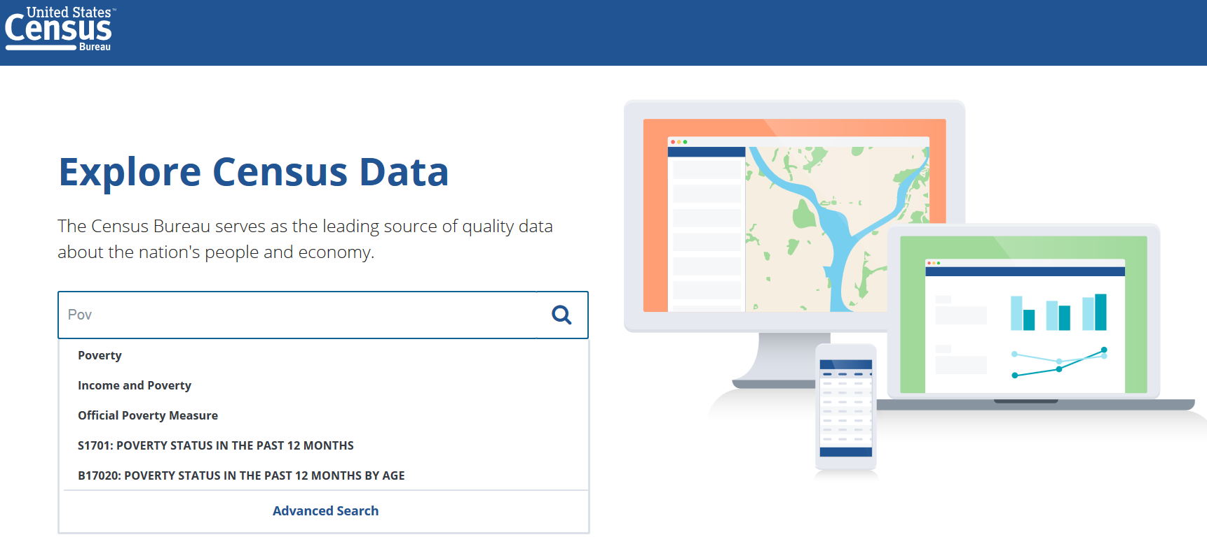
The Preview Site: data.census.gov
Notes:
I’m going to provide a quick demo of data.census.gov so that you can see our latest developments.
(DEMO NOTES)
REMEMBER: Data.census.gov is a preview site to show what we’re developing as we’re developing.
What is being built here will eventually support the search for all of census.gov.
We’re not finished, and that’s the point.
As part of our agile development process, we will continue to make incremental releases over the next year. We invite you in to play around now, while we’re still working.

Slide 12
Email us your thoughts: cedsci.feedback@census.gov
Notes:
After you explore the site….and by explore, I mean take a few minutes to play around with some of the new features, not stress yourself out over the details for right now…
We REALLY want to know what you think!
Your feedback is critical to this process, to be sure we’re getting data users what they want and need!
You can be the voice for the data users you serve, and for yourself.
Take a look at data.census.gov,
and email us your thoughts to cedsci.feedback@census.gov.

Slide 13
Questions/Feedback?
General feedback, please email: cedsci.feedback@census.gov
Specific questions? Please feel free to contact me!
Rob Chestnut
Communication and User Engagement
CEDSCI, U.S. Census Bureau
Robert.d.chestnut@census.gov
301-763-3786
Thank you!
Notes:
Thank you for your participation in today’s webinar!
We are grateful for your interest in being involved in how we improve the search experience on Census.gov, and are very much looking forward to your feedback! This presentation was intentionally made brief to give you some time to explore data.census.gov, and we hope you’ll take a few minutes to do that.
We will be conducting webinars in the coming months to look at other aspects of our development. The next one will likely take place in early March, so do keep an eye out if you would like to learn more about our focus at that point.
If you have questions about today’s session, we can take a few now. You can also contact us with general feedback at cedsci.feedback@census.gov, or you can reach out to me with specific questions.
Thank you!

